Slide 1
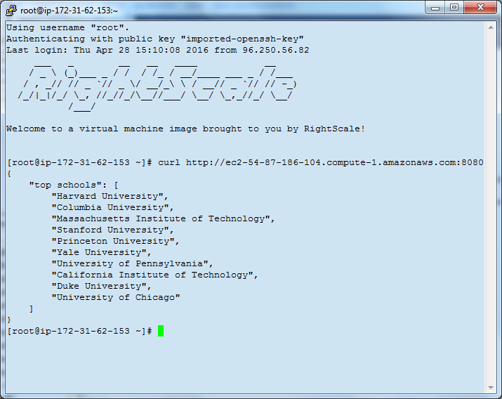
REST API: Top Schools

Slide 2
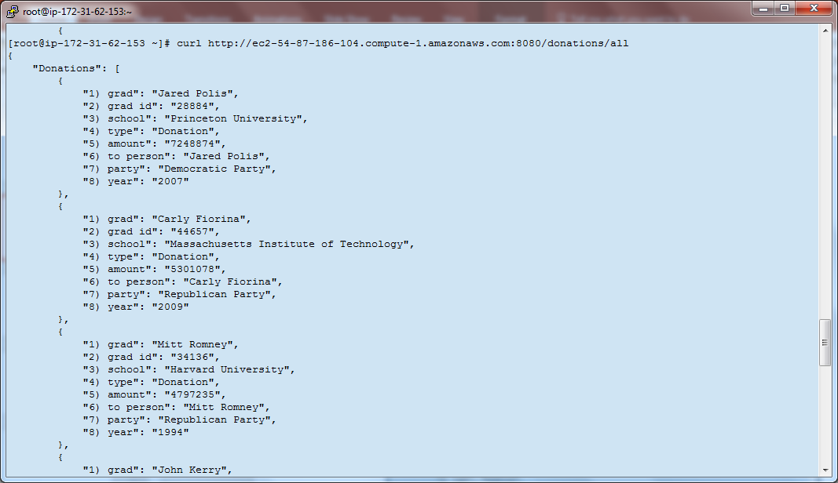
REST API: Top Political Donors across All Schools

Slide 3
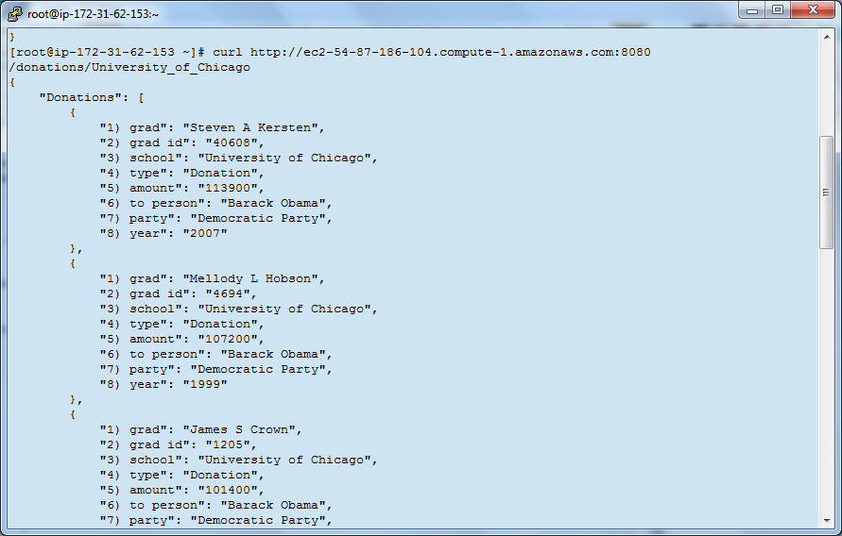
REST API: Top Donors for a Specific School

Slide 4
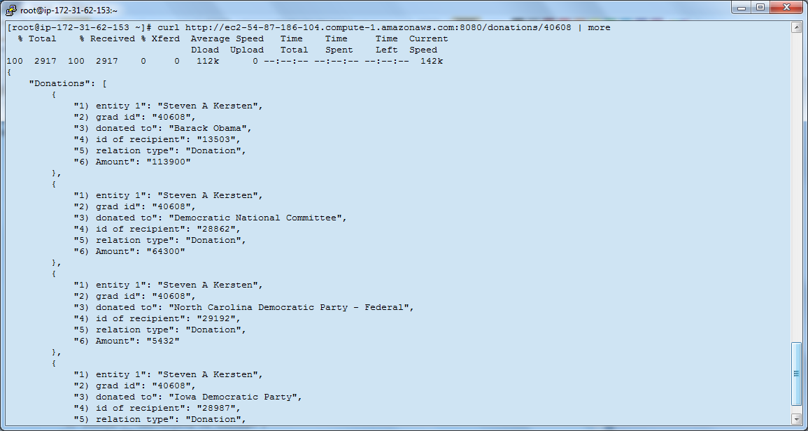
REST API: Top Donations made by a single graduate

Slide 5
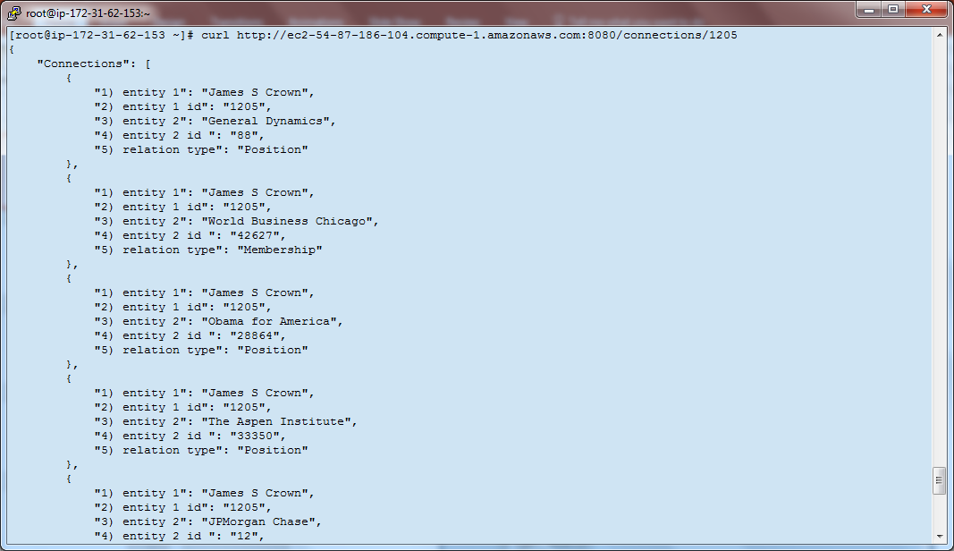
REST API: Connections of a Graduate, excluding Donations

Slide 6
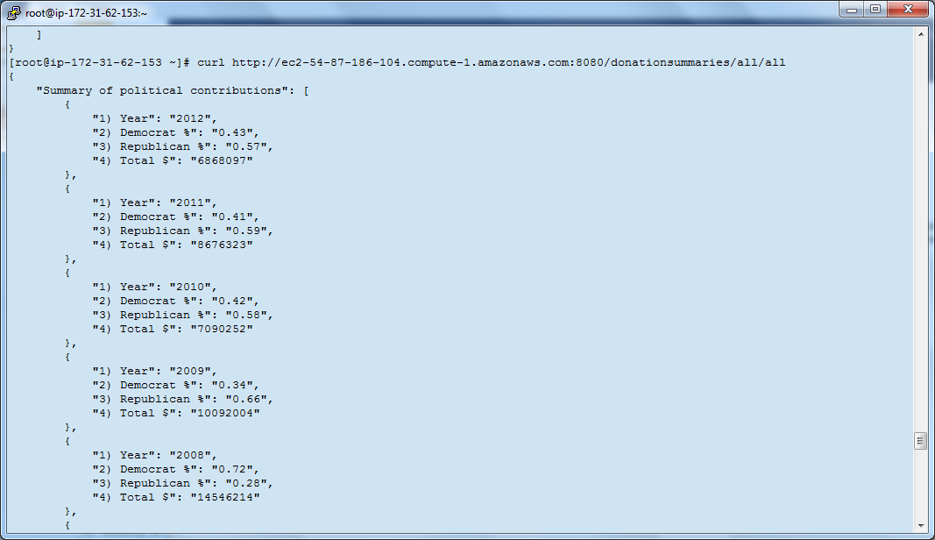
REST API: Summary: All Schools, All Years

Slide 7
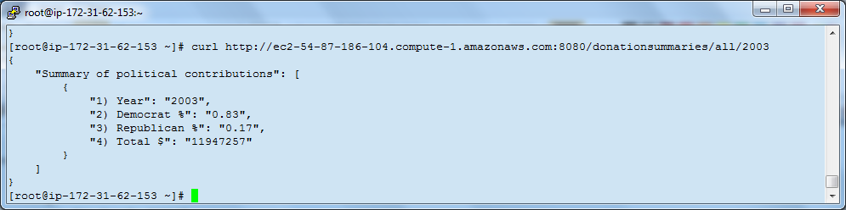
REST API: Summary: All Schools, Specific Year

Slide 8
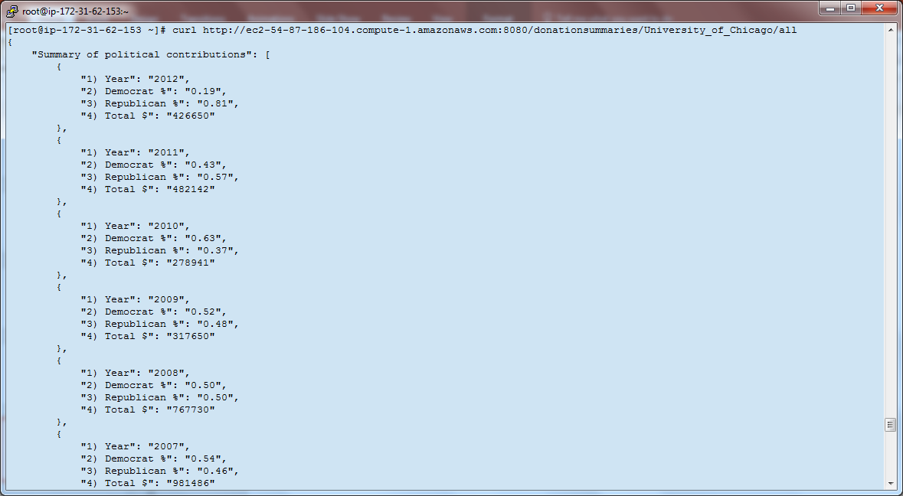
REST API: Summary: Specific School, All Years

Slide 9
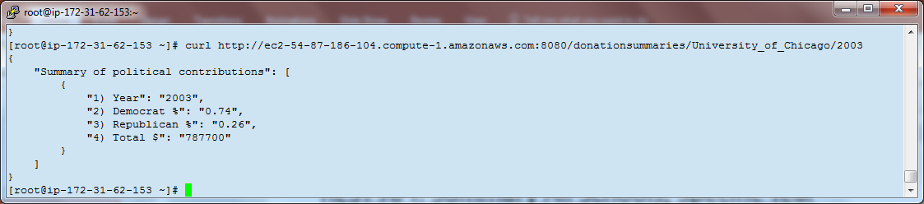
REST API: Summary: Specific School, Specific Year

